Slide 1
Tour Origin-Destination Choice Model
ActivitySim Consortium Meeting
September 28, 2021

Slide 2
Agenda
History & Objectives
Model Structure
Utilities
Results
Potential Use Cases
Q&A

Slide 3
History & Objectives
Migrate the existing SANDAG Mexican Resident Cross Border (CB) Travel Model from CT-RAMP to ActivitySim software
Prove ActivitySim’s promise of runtime performance and extensibility

Slide 4
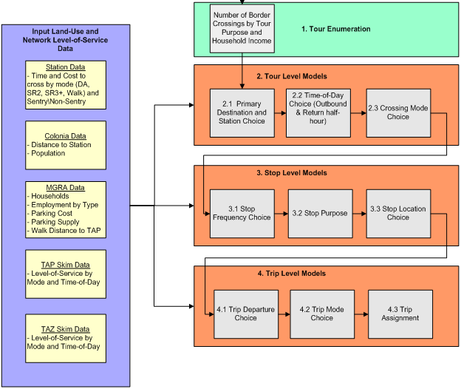
CB Model Structure
Talking about this submodel today

Slide 5
Tour OD Choice Steps
User inputs number of tours, such as 115,000
Assign each tour an origin and destination since neither is known
In this case, the origin is a port of entry for crossing border and the destination is the primary location within US

Slide 6
Tour OD Choice
POEs Today
San Ysidro
Otay Mesa
Tecate
Dest
B1
Employment size terms
Employment size terms
Dest A1
Crossing mode choice logsum
Crossing mode choice logsum
POE
B
US
POE
A
Accessibility to population
Mexico
Accessibility to population

Slide 7
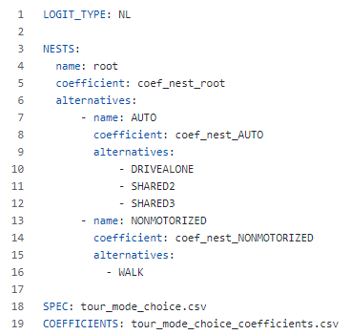
Tour OD Choice Utilities
  Tour mode nesting structure
Origin Zone
  Accessibility to population
  POE constants
Destination Zone
  Land use size term
Origin to Destination
  Tour mode choice logsum
  Piecewise linear distance
Tour purpose constants
All coded as flexible ActivitySim expression files

Slide 8
Tour Mode Choice Logsum
Origin Zone
  Border wait time by mode and pass type
Destination Zone
  No terms
Origin to Destination
  Roundtrip trip mode choice logsum for each possible tour mode
    Depends on new added feature
    Compute trip mode choice logsum conditional on tour mode
    COMPUTE_TRIP_MODE_CHOICE_LOGSUMS: True
Mode and tour purpose constants
All coded as flexible ActivitySim expression files

Slide 9
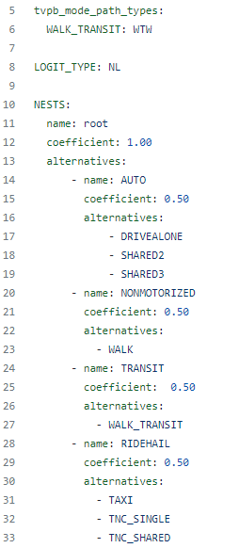
Trip Mode Choice Utilities
  Trip mode nesting structure
Origin Zone
  No terms
Destination Zone
  Parking cost
Origin to Destination
  Time, distance, cost by mode
  Skims by value-of-time group
  Transit virtual path builder logsum
Mode and purpose constants
Makes use of ActivitySim 3 zone system TVPB!
All coded as flexible ActivitySim expression files

Slide 10
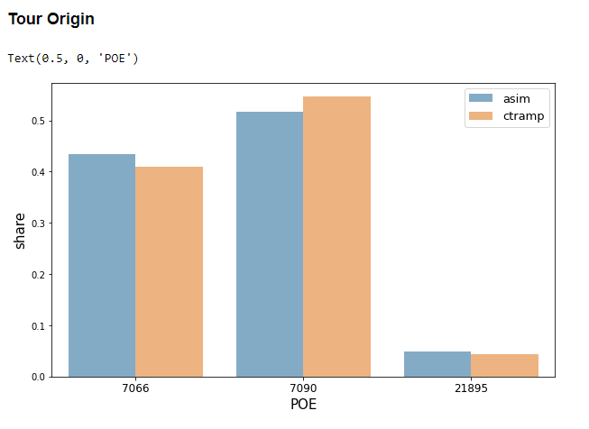
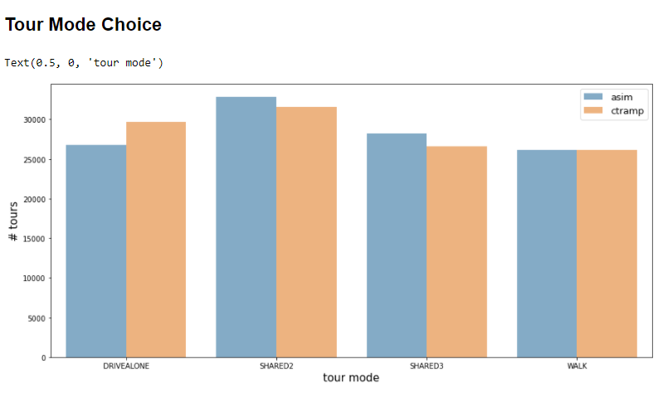
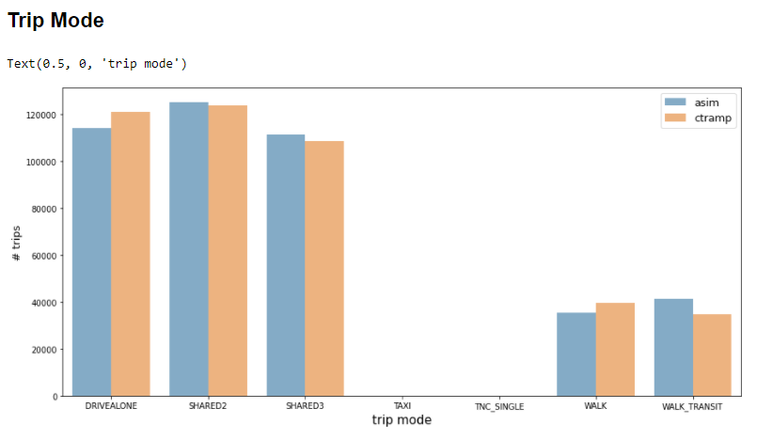
Results
Rigorous effort to match previous CT-RAMP model results
See Jupyter Notebook
Run times 50-60% faster than before (~20 to 25 min)

Slide 11
Potential Use Cases for Tour OD Model
Demand that starts with enumerating tours or trips rather than a traditional synthetic population
To study origin zone policy decisions (e.g., border crossing station choice and mode choice)
  Internal/external models
  Multiple airport choice models
  Visitor models
  University travel models
  Special generator / event models
Others?

Slide 12
Q&A
Questions? Next steps? (We’ll address the PR comments)
Improvements available in the pull request
https://github.com/ActivitySim/activitysim/pull/481
Thank you SANDAG for the willingness to expend project resources and schedule for the good of ActivitySim

Slide 13
Ben Stabler
SENIOR DIRECTOR
Ben.Stabler@rsginc.com
Joel Freedman
SENIOR DIRECTOR
Joel.Freedman@rsginc.com
Max Gardner
SOFTWARE ENGINEER
Max.Gardner@rsginc.com

