Slide 1
PMPI SUCCESSOR
RESTART 2017
Code Name QMPI
LLNL-PRES-xxxxxx
This work was performed under the auspices of the U.S. Department of Energy by Lawrence Livermore National Laboratory under contract DE-AC52-07NA27344. Lawrence Livermore National Security, LLC

Slide 2
Why redo PMPI?
Weak symbol intersection is brittle
  Depends on the OS
Limited to a single tool
  One set of indirections
Forces tools to be monolithic
  Single shared library

Slide 3
Requirements
Support multiple concurrent tools in a single process
Link time or runtime enablement
Low to no overhead when no tool is attached
  Possibility for zero overhead when disabled
No loss of functionality compared to existing PMPI
  Complete coverage of all MPI routines (except where exempted already in MPI 3)
  Complete coverage of all tool functionality
    Incl. changes to parameters or routines used
  All language bindings (C, mpif.h, use mpi, use mpif08)
Support for pre and post call activation
  Basically wrapper functionality
Tools can implement functionality in C (in one place) regardless of language bindings used
Integration with MPI thread support
Notes:
C vs. Fortran – what to do if some types are different (e.g., request type for NEC MPI)
What about Fortran only functions?

Slide 4
QMPI:
A View from the Tool
Focus: Interface the tool would see
Let’s ignore:
Configuration issues, Initialization, Complex Tool DAGs, …

Slide 5
Groundrules
Maintain the wrapping concept
  Only way to maintain all functionality
Interface and all tools will be C only
  Fortran mapping has to be taken care of by the MPI library
  Tools are responsible for matching runtimes when using C++
Support for simple tool stacks only
  Nested wrapping
  No DAGs, no inter-tool services, no coordination, no dependencies
Tools are by default independent of each other
  Can run on their own
  Can assume a standard compliant implementation of MPI routines to build upon (the old PMPI interface)
  Have to provide a standard compliant implementation of MPI, which consists of:
    Wrapped routine (defined MPI routines – or close to, see below)
    MPI routines not wrapped (when MPI=PMPI)

Slide 6
Tools Responsibilities
Tools implement wrapper routines
  Set of routines with well defined names
    One name defined for each MPI routine
    Extended prototype with extra fields
    E.g.: QMPI_Comm_rank(MPI_Comm comm, int *rank, <extra data>)
  Tool routines must call “follow on routine”, the match to the old PMPI
    Assigned by MPI during initialization
    Can be actual MPI or another tool – transparent
  Routines not implemented are handled by MPI
    Automatically set to a “follow-on” routine
The implemented wrappers combined with all default routines (which can be assumed to adhere to the MPI standard) must again implement a coherent version of the MPI standard
Notes:
Does it have to be a well defined routine?

Slide 7
Basic Wrapping
Each tool implements a set of routines it wraps
Tools have independent instances
  Separate storage space
Each tool instance has the following “available”:
  A functional table with all “PMPI” / follow on routines
  A pointer to store internal information
Wrapping process:
  Int QMPI_X(…)
  {
  qmpi_x_t pqmpi_x;
  MPI_Table_query(“QMPI_X”, &pqmpi_x,table);
  ... Do work ...
  err=pqmpi_x(...);
  ... Do work ...
  return err;
  }
Note: query routine should be called once during initialization

Slide 8
Multiple Tools
App
Exposed MPI_Send
Plugin 1: Profile tool (QMPI_Send interface)
Plugin 2: Trace tool (QMPI_Send interface)
Actual MPI_Send
Guts of MPI_Send

Slide 9
Magic Data Available to Tools
Each tool instance needs two pieces of data
  Pointer to its own state
  Pointer to a table of PMPI functions to call
Question where does it get that data from?
  Pointer to instance state must be passed in from previous tool
    Pointer must be used to store PMPI function table
    Pointer must be used to store pointer to instance for follow on tool
  Basically: context for all tools gets handed down
Where does this data come from originally?
  Setup during intialization routine
    Passes in context for follow-on tool
    Passes in PMPI function table
  Tools then stores that information

Slide 10
Concept 1: Function Tables
Used to store one function pointer for each MPI function
  Describes complete interface
Tools can use that to query “follow-on functions”
Specified as opaque objects

Slide 11
APIs for Function Tables
Create a Table
  Out: table handle
Destroy a Table
  In/Out: table handle
Copy a Table
  In: src and dst table handles
Query one Function
  In: table handle, function ID or name
  Out: function
Set one Function
  In: table handle, function ID or name, function
Unset one Function
  In: table handle, function ID or name
Needs enumeration of all MPI functions
  Alternative: strings (?)
Likely to contain other tool routines (init/finalize/…)
Notes:
Should we let MPI own all tables – tools can’t create, destroy, copy them – we can just manipulate them
We still pass a opaque objects from/to tools

Slide 12
Concept 2: Tools and Instances
Tools expose a set of intercepted routines
  Typically implemented as a shared library
  Magically gets loaded
    Let’s discuss that later
  Doesn’t do anything by itself
    No automatic interception
    Just provides routines
Tool instances are built from tools
  Use the set of intercepted routines
  Instances have their own context
    Instances don’t share context
  Context = void pointer to store information

Slide 13
Bringup steps (before MPI_Init)
Step 1: tools get registered
  This loads the tools
  MPI now knows about them
Step 2: tools get initialized
  Make their wrapped functions known
  Provide meta data
Step 3: MPI creates a list of tool to instantiate
  Let’s leave that to magic
  Result is an ordered list of tools to create instances for
Step 4: tools instances get initialized
  Tools get context
  Done bottom up (see late why)

Slide 14
Step 1: Tool Registration
Option 1 / Callback
  MPI searches for available intercepts and remembers them
  Tool implements a well defined callback routine (special QMPI routine)
  Routine gets called from MPI
  Tools fills out a “who am I” record and returns it
  Returns pointer to initialization routine
Option 2 / Self registration
  Tool gets “magically” initialized (ini routines)
  Tool registers itself by calling the MPI function for tool registration
  Tool passes that table to MPI
  Tools fills out a “who am I” record and passes it
  Provides pointer to initialization routine
Should we allow (or enable for the future) dynamic registration?
What about dynamic addition of routines?
Notes:
What about a setup where not all processes exists in the beginning of time?
Need to make sure we cover the case for static linking

Slide 15
Step 2: Tool Initialization
MPI calls initialization routines
  Arbitrary order
  MPI passes function table
    Represents all intercepted routines MPI could find
      Typically used for option 1
    Can be manipulated during the initialization
      Typically used for option 2
This step could be combined with Step 1
Notes:
The table could be static since it is per tool but then we can’t do it opaque
either table of void* or a huge struct of all pointers with correct prototypes
this would make combining step 1 and 2 possible due to early initialization

Slide 16
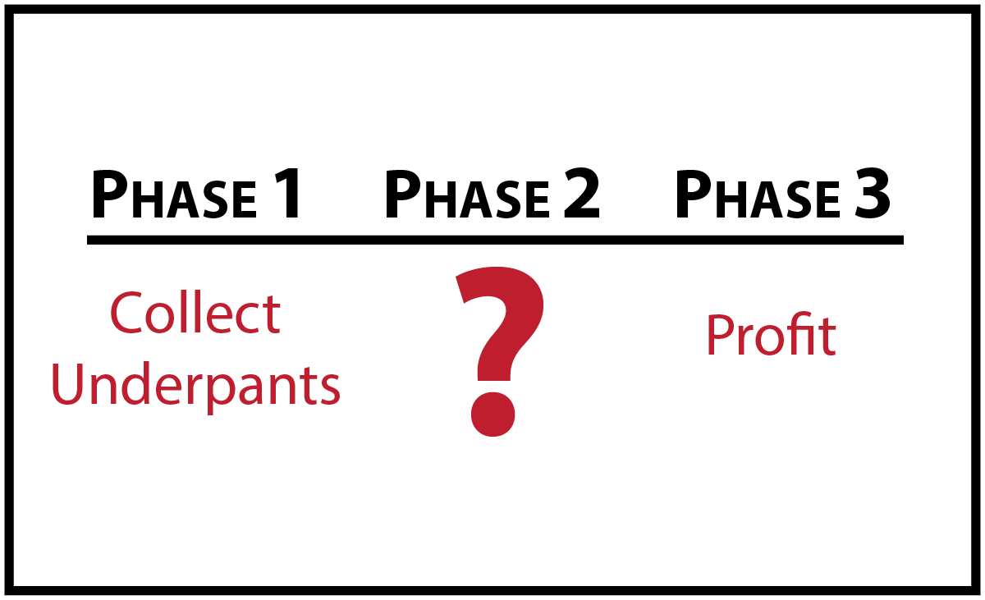
Step 3: Magic

Slide 17
Step 3: Magic
MPI decides on a list of tool instances to use
  Creates a tool stack
  Mechanism open (e.g., Env. Variable or MPI_T variable)
These tools are nested
MPI App
Full MPI API
Tool 1 / top
Full MPI API
Tool 2 / top
Full MPI API
“PMPI” Routine
Tool 2 / bottom
Tool 1 / bottom
MPI App
Notes:
Only do a simple list
Order it by explict order or by priority
MPI creates one instance per tool only
More complicated things require a separate specification, which is outside of MPI (at least for now)

Slide 18
Step 4: Tool Instance Initialization
This step happens before MPI_Init and is a local call
  No communication in this call, yet
  Is this sufficient? Or are there use cases where we would need this?
Each tool gets initialized in reverse order
  Instance initialization routine stored in function table for tool
  Do we need a fixed order so we can profile initialization?
    Perhaps not if this is before MPI_Init
Initialization routine gets passed
  IN/OUT: A void pointer to store tool instance context
  IN: An opaque void pointer
    This is the context for the follow on tool
  IN: A function table containing the PMPI routines
    Who owns this table?
    When can it change and who can do this?
    Or can this just be a tool ID
Tool responsibilities
  Create storage structure and hook it to void pointer
  Store opaque pointer and function table in that structure

Slide 19
Wrapping
  Int QMPI_X(<MPI arguments>, void* context, MPI_blob blob)
  {
  retrieve function table from context -> next_table
  retrieve opaque pointer from context -> next_context
  qmpi_x_t pqmpi_x;
  MPI_Table_query(“QMPI_X”, &pqmpi_x,&next_context,next_table);
  ... Do work ...
  err=pqmpi_x(<MPI arguments>, next_context, blob);
  ... Do work ...
  return err;
  }
Note: query routine should be called once during initialization
Blob contains MPI internal information, such Fortran flag
When next routine is not implemented in the next level, MPI would point past it to the next tool or MPI itself
  Open question: how to get the right context then?
  Must have context on a per function basis (changes in red above)
Notes:
Or do you want to enforce that this is done every time to allow dynamic tools – tool tables can change
This requires a fast implementation of the tables – like a real table
Is the table dyamic – who owns the table?
The table lookup could also be global with passing an ID
would allow MPI to change the table dymically
do we want that and how?
Is this a problem when combining with sessions?
Should this be combined with MPI_T Events, notification in case of tools have changed
Get rid of strings for query routines
may not matter if we change to a table or struct
Need some guarantees on when changes to the table happen: perhaps through events
Tool gets passed the new table and swap it in on demand when its ready

Slide 20
What Needs to be Standardized
Function Tables
  Type and access function
  Direct table or struct – but this exposes a lot to the user
    Each entry is a tuple (fct. Pointer / Context Pointer)
  Open question: struct (type safe) or enum & array (we could iterate)
    Leaning towards struct, at least for the function table
  Or should we hide all this beyond a “function” that could be a macro
    If we have one macro, then we have no type safety / need enum as input
      Cannot be done type safe if we use a function / need to cast in this case
      A macro could be type safe, but would be ugly
    One macro for function QMPI_Query_MPI_Send
Shadow API
  All MPI functions with slight modifications
  ”Chance to get it right”
Initialization routines for tools and tool instances
  Includes the “who am I” record
Query routines
  Ability to see which tools (and tool instances?) are present
Specification of tools to load
  Do we need that or is that out of the specification?

Slide 21
Can the Query be a Type Safe Macro?
#define BCAST_T. int (*bcast)( .... )
#define QUERY( BCAST ) (BCAST ## _T) table[ BCAST ]
Comfort level of putting this into the standard
THIS NEEDS MORE DISCUSSION

Slide 22
To Consider: Use of MPI_T
Each tool does MPI_T_Init
  New tool, new variables
MPI_NEXT_FUNCTION variable would have a different meaning for each tool
  Bound to an MPI FUNCTION OBJECT
THIS NEEDS MORE DISCUSSION

Slide 23
Issues
Transition between PMPI and QMPI
  Deprecate PMPI
  For a while this needs to be interoperable
    PMPI is likely on top of the new infrastructure
    In intercepts the actual MPI calls from the app
Threading support
  What if tool needs thread support itself
Who am I field
  Versioning
  Unique name

Slide 24
Dynamic Tools / Open Issues
Changing “next tables”
  When can it happen
  Who gets notified
  Thread safety
Probably should have dynamic updates in tables
  Opaque objects may be too slow
Newly loaded tools need to be initialized
  Need a barrier?
What about removing
  Can a tool just finalized itself?

Slide 25
Now What About Complex Tools?
We do want full P^{n}MPI functionality
  Tool DAGs / Diamond stacks
  Services for intra tool communication
  Support for cooperating tool modules
BUT: this is not MPI’s task
  Research
  Requires external specification
However, this proposal allows developers to build tools that
  Are implemented as a tool themselves
  Provide this functionality
  Can integrate existing tools without changes
    No more patching like in P^{n}MPI

Slide 26
Complex Tool Use Cases
This should be implementable by a new tool that uses the interface, without changing the interface
Only run on certain nodes/processes/communicator
  Argument for centralized table registry?
  When can we query a rank?
Create arbitrary tool DAGs

